Slide 1
A Hybrid Strategy For Illuminant Estimation Targeting Hard Images
Roshanak Zakizadeh¹ Michael Brown² Graham Finlayson¹
¹University of East Anglia ²National University of Singapore
Color & Photometry in Computer Vision Workshop ICCV2015
Santiago, Chile

Slide 2
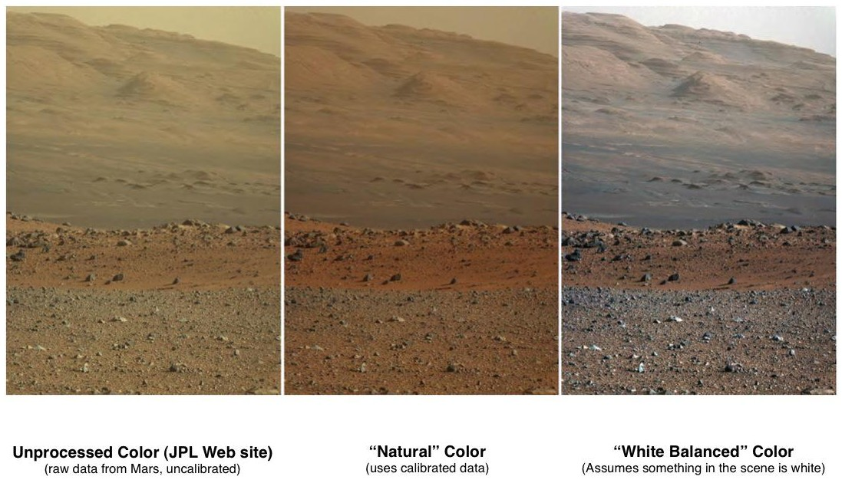
Illuminant Estimation
Images taken from NASA webpage: http://photojournal.jpl.nasa.gov/catalog/PIA16800
Notes:
A brief introduction on illuminant estimation

Slide 3
Motivation for this work

Slide 4
Motivation for this work
White balance algorithms

Slide 5
Motivation for this work
White balance algorithms
1971
1980
1980
2014
2015
White patch
Grey world
Gamut
Corrected moment
CNNs methods

Slide 6
Motivation for this work
White balance algorithms
1971
1980
1980
2014
2015
White patch
Grey world
Gamut
Corrected moment
CNNs methods
Performance evaluation of algorithms

Slide 7
Motivation for this work
White balance algorithms
1971
1980
1980
2014
2015
White patch
Grey world
Gamut
Corrected moment
CNNs methods
Gamut
Performance evaluation of algorithms
Mean error (Branard et al. TIP02)
Median error (Hordley & Finlayson JOSAA06)
Trimean error (Gijsenij et al. JOSAA09, Gijsenij et al. TIP11)
method’s performance across an entire dataset.
Notes:
A chronicle of illuminant estimation algorithms. They are all ranked based on the following statistics over a chosen benchmark dataset.
none of the prior works have examined if there is any commonality in these statistics across the images in the dataset.
such aggregate metrics make it hard to determine the performance between methods in terms of individual images and if there are "hard images“ where all algorithms or a certain group of algorithms fail for these images.

Slide 8
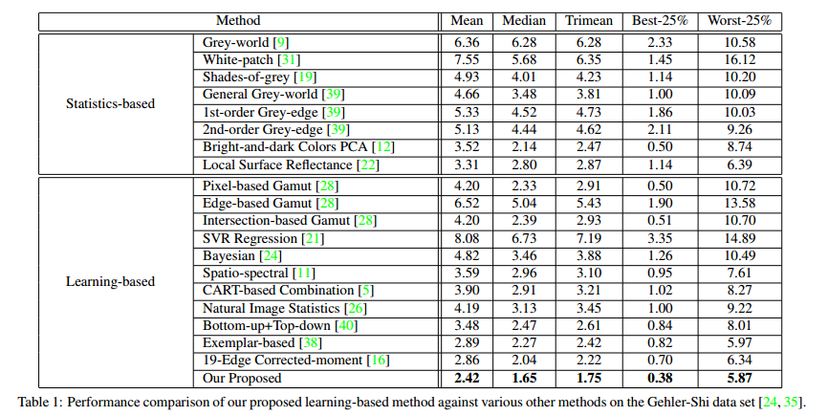
Motivation for this work
Example from Cheng et al, CVPR 2015
Notes:
This is how people report the results
none of the prior works have examined if there is any commonality in these statistics across the images in the dataset.
such aggregate metrics make it hard to determine the performance between methods in terms of individual images and if there are "hard images“ where all algorithms or a certain group of algorithms fail for these images.

Slide 9
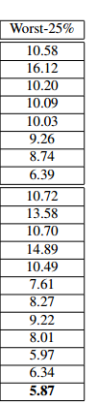
Are these the same hard images?
Our motivation. . . .

Slide 10
Are these the same hard images?
Our motivation. . . .
  analyze the set of images algorithms perform poorly on.

Slide 11
Are these the same hard images?
Our motivation. . . .
  analyze the set of images algorithms perform poorly on.
Do algorithms perform poorly on the same images?

Slide 12
Are these the same hard images?
Our motivation. . . .
  analyze the set of images algorithms perform poorly on.
Do algorithms perform poorly on the same images?
If so, then these are “hard”.

Slide 13
Are these the same hard images?
Our motivation. . . .
  analyze the set of images algorithms perform poorly on.
Do algorithms perform poorly on the same images?
If so, then these are “hard”.
If “hard” images exist, we identify them?

Slide 14
Are these the same hard images?
Our motivation. . . .
  analyze the set of images algorithms perform poorly on.
Do algorithms perform poorly on the same images?
If so, then these are “hard”.
If “hard” images exist, we identify them?
If we can identify them, can we tailor illumination estimation algorithms for them?

Slide 15
Illuminant Estimation Algorithms
Statistical based algorithms
White-patch/MaxRGB (Land77)
Gray-world (Buchsbaum80)
Shades of gray (Finlayson&Trezzi04)
Edge-based color constancy (Weijer07)
Pixel brightness (Cheng14)
Learning based algorithms
Gamut mapping (Forsyth99)
Natural image statistics (Gijsenij&Gever07)
Bayesian method (Gehler08)
General gamut mapping (Gijsenij09)
Spatial correlation (Chakrabarti12)
Exemplar-based (Vaezi Joze13)
Corrected moment (Finlayson14)
CNNs (Bianco15)
CNNs (Barron15) ….
Fast simple algorithms.
Can be used onboard camera.
Better performance in many cases.
Complicated and slower.
Better used as an offline solution.
Notes:
Simple statistical methods are more practical because they are easy to implement in cameras. But still the performance of the learning based methods is better.

Slide 16
Performance of combinations of algorithms on Gehler-Shi dataset
Statistical based algorithms
Shades of gray S1
Gray-world S2
Edge-based color constancy
  1st order grey edge S3
  2nd order grey edge S4
White-patch/MaxRGB S5
Learning based algorithms
Exemplar-based L1
Natural image statistics L2
General gamut mapping
  Edge based L3
  Pixel based L4
  Intersection based L5
Bayesian method L6
Spatial correlation L7
Notes:
The 12 labelled algorithms we used in our experiment. These are the most refereed algorithms in literature survey and their results for many datasets are available on www.colorconstancy.com

Slide 17
Performance of combinations of algorithms on Gehler-Shi dataset
Statistical based algorithms
Shades of gray S1
Gray-world S2
Edge-based color constancy
  1st order grey edge S3
  2nd order grey edge S4
White-patch/MaxRGB S5
Learning based algorithms
Exemplar-based L1
Natural image statistics L2
General gamut mapping
  Edge based L3
  Pixel based L4
  Intersection based L5
Bayesian method L6
Spatial correlation L7
http://colorconstancy.com/
Notes:
The 12 labelled algorithms we used in our experiment. These are the most refereed algorithms in literature survey and their results for many datasets are available on www.colorconstancy.com

Slide 18
Performance of combinations of algorithms on 482 images of Gehler-Shi* dataset
Combinations with most ‘hard’ images |  |  |  |  |  |  |  | Combinations with least ‘hard’ images
Methods |  |  |  |  | Failed images | Time per image (min) |  | Methods |  |  |  |  | Failed images | Time per image (min)
S2 | S3 | S5 | L3 | L7 | 84 | 1.5 |  | L1 | L2 | L4 | L6 | L7 | 31 | 12.6
S2 | S3 | S5 | L3 | L6 | 80 | 9.8 |  | S4 | L1 | L2 | L5 | L7 | 27 | 3.7
S2 | S3 | S5 | L3 | L4 | 78 | 1.8 |  | S1 | S4 | L1 | L2 | L6 | 24 | 11.2
S2 | S3 | S4 | S5 | L3 | 73 | 1 |  | S2 | L1 | L2 | L6 | L7 | 22 | 11.7
S1 | S2 | S3 | S4 | S5 | 69 | 0.36 |  | S2 | S4 | L1 | L2 | L7 | 19 | 2.87
S1 | S2 | S4 | S5 | L4 | 64 | 1.2 |  | S2 | S4 | L1 | L6 | L7 | 18 | 11.1
*Gehler et al. CVPR2008, Shi & Funt SFU2010
Notes:
In our experiment we study the performance of combinations of five algorithms out of 12 on 482 images of canon5D camera from Gehler-Shi dataset. We are counting the number of images for which the combination has failed. As well as the time it takes for all five algorithms to run on one images. Obviously the running time is more where there are more learning based methods in the combination but such combinations result in lower number of failure cases.

Slide 19
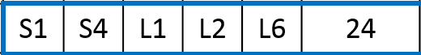
Performance of combinations of algorithms on 482 images of Gehler-Shi dataset
Combinations with most ‘hard’ images |  |  |  |  |  |  |  | Combinations with least ‘hard’ images
Methods |  |  |  |  | Failed images | Time per image (min) |  | Methods |  |  |  |  | Failed images | Time per image (min)
S2 | S3 | S5 | L3 | L7 | 84 | 1.5 |  | L1 | L2 | L4 | L6 | L7 | 31 | 12.6
S2 | S3 | S5 | L3 | L6 | 80 | 9.8 |  | S4 | L1 | L2 | L5 | L7 | 27 | 3.7
S2 | S3 | S5 | L3 | L4 | 78 | 1.8 |  | S1 | S4 | L1 | L2 | L6 | 24 | 11.2
S2 | S3 | S4 | S5 | L3 | 73 | 1 |  | S2 | L1 | L2 | L6 | L7 | 22 | 11.7
S1 | S2 | S3 | S4 | S5 | 69 | 0.36 |  | S2 | S4 | L1 | L2 | L7 | 19 | 2.87
S1 | S2 | S4 | S5 | L4 | 64 | 1.2 |  | S2 | S4 | L1 | L6 | L7 | 18 | 11.1
Notes:
Let’s pull out one combination for more analysis. This particular combination results in 24 images.

Slide 20

Performance of combinations of algorithms on 482 images of Gehler-Shi dataset
Method’s error is above threshold (i.e. method fails)
Method’s error is below threshold (i.e. method succeeds)
Each column represents an image in the dataset
S1
S4
Methods
L1
L2
L6
Image ID
1 2 3 4 . . . . 30 31 . . . . . 444 . . . . . . . 479 480 481 482
Easy image
Notes:
This is how this combination performs on all 482 images of Canon5D. The white squares show the failed images.

Slide 21
Performance of combinations of algorithms on 482 images of Gehler-Shi dataset
Method’s error is above threshold (i.e. method fails)
Method’s error is below threshold (i.e. method succeeds)
Each column represents an image in the dataset
S1
S4
Methods
L1
L2
L6
Image ID
1 2 3 4 . . . . 30 31 . . . . . 444 . . . . . . . 479 480 481 482
(3 or more fail)
Hard image
Hard image
Easy image
Easy image
Notes:
If 3 or more algorithms fail for an image we call that image a hard image. Here you can see 2 examples.

Slide 22
Performance of combinations of algorithms on 482 images of Gehler-Shi dataset
Method’s error is above threshold (i.e. method fails)
Method’s error is below threshold (i.e. method succeeds)
Each column represents an image in the dataset
S1
S4
Methods
L1
L2
L6
Image ID
1 2 3 4 . . . . 30 31 . . . . . 444 . . . . . . . 479 480 481 482
(all 5 succeed)
(3 or more fail)
Hard image
Hard image
Easy image
Easy image
Notes:
If all five algorithms succeed to estimate the illuminant for that image it is an easy one. You can see 2 examples here. The criteria for success or failure is that the error introduced by the algorithm for that particular image is lower or higher than a threshold.
69 out of 482 hard images and 173 out of 482 are easy images

Slide 23
Performance of combinations of algorithms on 482 images of Gehler-Shi dataset
Combinations with most ‘hard’ images |  |  |  |  |  |  |  | Combinations with least ‘hard’ images
Methods |  |  |  |  | Failed images | Time pi (min) |  | Methods |  |  |  |  | Failed images | Time pi (min)
S2 | S3 | S5 | L3 | L7 | 84 | 1.5 |  | L1 | L2 | L4 | L6 | L7 | 31 | 12.6
S2 | S3 | S5 | L3 | L6 | 80 | 9.8 |  | S4 | L1 | L2 | L5 | L7 | 27 | 3.7
S2 | S3 | S5 | L3 | L4 | 78 | 1.8 |  | S1 | S4 | L1 | L2 | L6 | 24 | 11.2
S2 | S3 | S4 | S5 | L3 | 73 | 1 |  | S2 | L1 | L2 | L6 | L7 | 22 | 11.7
S1 | S2 | S3 | S4 | S5 | 69 | 0.36 |  | S2 | S4 | L1 | L2 | L7 | 19 | 2.87
S1 | S2 | S4 | S5 | L4 | 64 | 1.2 |  | S2 | S4 | L1 | L6 | L7 | 18 | 11.1
Statistical-based methods
If 3 or more algorithms from this combination fail the image is labelled as hard.
Notes:
The combination with all statistical methods is the fastest one but results in relatively high number of failure cases. Such combination could provide a good basis for deciding an image is hard or easy. Plus running five statistical based algorithms by the camera seems reasonable. So if the errors for 3 or more statistical based algorithms are higher than a threshold we call that image a hard image.

Slide 24
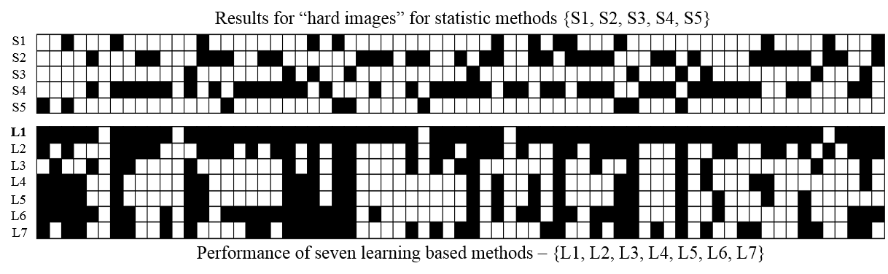
Performance of Statistical based algorithms on hard images
Notes:
The 69 images out of 482 for which the combination of statistical method have failed.

Slide 25
Performance of learning based algorithms on hard images
Exemplar-based method (Joze PAMI2014)
Notes:
We can see the performance of the 7 learning based methods for these 69 hard images. Overall better performance. In particular L1 = exemplar-based can succeed on most of these images.

Slide 26
Hybrid method for targeting hard images feature selection
Notes:
We have studies the position of the estimated illuminant for hard vs easy images using statistical based methods in different color spaces such as raw RGB, chromaticity diagram, with regard to the plankian line, etc. Raw RGB represent them the best. Here you can see the position of the mean of 5 estimates for hard vs easy images on the left. On the right you see the estimated illuminant for an image which has the median angle from the mean of the five estimates.

Slide 27
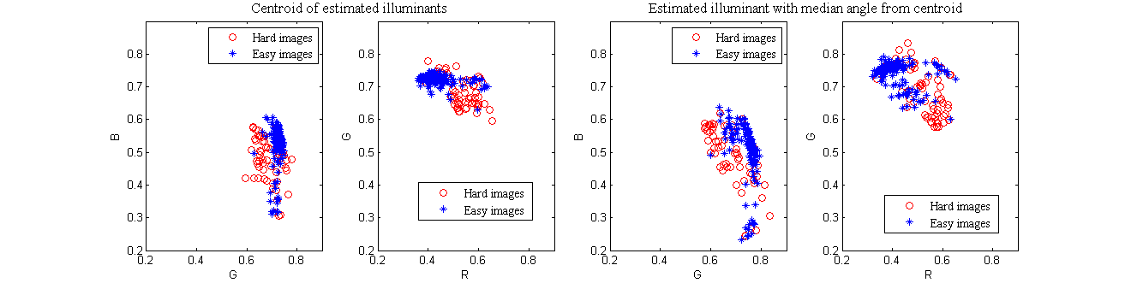
Hybrid method for targeting hard images feature selection
Centroid of five estimated illuminants
Estimated illuminant with median angle from the centroid estimate
Notes:
We have studies the position of the estimated illuminant for hard vs easy images using statistical based methods in different color spaces such as raw RGB, chromaticity diagram, with regard to the plankian line, etc. Raw RGB represent them the best. Here you can see the position of the mean of 5 estimates for hard vs easy images on the left. On the right you see the estimated illuminant for an image which has the median angle from the mean of the five estimates.

Slide 28
Hybrid method for targeting hard images feature selection
Feature | Overall accuracy | Hard image accuracy | Easy image accuracy
Centroid (mean) | 93.6% | 85% | 96.6%
Median from centroid | 86.7% | 68.3% | 94.3%
Standard deviation (std) | 82% | 42.3% | 95.9%
Centroid + std | 89.7 % | 68.1% | 95.9%
Median + std | 85.4% | 59.2% | 94.7%
Notes:
In RAW RGB space, we have tested the accuracy of our classification model for these features. NOTE: std is just an angle (standard deviation of five estimates from the centroid)

Slide 29
Hybrid method for targeting hard images feature selection
Feature | Overall accuracy | Hard image accuracy | Easy image accuracy
Centroid (mean) | 93.6% | 85% | 96.6%
Median from centroid | 86.7% | 68.3% | 94.3%
Standard deviation (std) | 82% | 42.3% | 95.9%
Centroid + std | 89.7 % | 68.1% | 95.9%
Median + std | 85.4% | 59.2% | 94.7%
Notes:
We ultimately stayed with the mean of the five estimates. The classifier based on this feature has the highest accuracy, specially with classifying hard images.

Slide 30
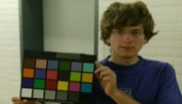
Hybrid method for targeting hard images overall procedure
Training images
Training Phase
Notes:
We are presenting our hybrid method as following …..
Using cross fold validation, for the training images ….

Slide 31
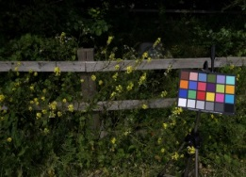
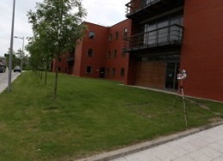

Hybrid method for targeting hard images overall procedure
Training images
Illuminant estimation
Simple statistics algorithms:
{S1,S2,S3,S4,S5}
Calculate errors
Ground-truth illuminants
$$\{ε_{1},ε_{2},ε_{3},ε_{4},ε_{5}\}$$
At least 3 > threshold (t2)
All 5 < threshold (t1)
Hard image
Easy image
Training Phase
Notes:
The illuminant is estimated using the simple-based algorithms. The error is calculated based on the ground truth illuminant. Remembering the criteria for labelling hard and easy images. We label the images in the training set.

Slide 32
Hybrid method for targeting hard images overall procedure
Training images
Illuminant estimation
Simple statistics algorithms:
{S1,S2,S3,S4,S5}
Feature extraction
(mean of 5 estimated illuminants)
Calculate errors
Ground-truth illuminants
$$\{ε_{1},ε_{2},ε_{3},ε_{4},ε_{5}\}$$
At least 3 > threshold (t2)
All 5 < threshold (t1)
Hard image
Easy image
Training Phase
Notes:
During the feature extraction the mean of five estimates are calculated per image.

Slide 33
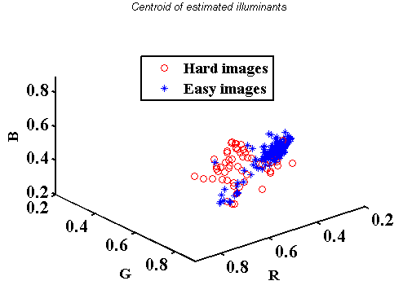
Hybrid method for targeting hard images overall procedure
Training images
Illuminant estimation
Simple statistics algorithms:
{S1,S2,S3,S4,S5}
Feature extraction
(mean of 5 estimated illuminants)
Calculate errors
Ground-truth illuminants
Hard
or Easy
$$\{ε_{1},ε_{2},ε_{3},ε_{4},ε_{5}\}$$
At least 3 > threshold (t2)
All 5 < threshold (t1)
Hard image
Easy image
Training Phase
Notes:
Observing the mean estimates in the RAW RGB space for the training images labelled as hard or easy, they can be classified.

Slide 34
Hybrid method for targeting hard images overall procedure
Training images
Illuminant estimation
Simple statistics algorithms:
{S1,S2,S3,S4,S5}
Feature extraction
(mean of 5 estimated illuminants)
Calculate errors
Ground-truth illuminants
Hard
or Easy
$$\{ε_{1},ε_{2},ε_{3},ε_{4},ε_{5}\}$$
At least 3 > threshold (t2)
All 5 < threshold (t1)
Hard image
Easy image
Learn SVM classifier
Training Phase
Notes:
We build an SVM classifier which serves as our model for classification hard and easy images.

Slide 35

Hybrid method for targeting hard images overall procedure
Training images
Illuminant estimation
Simple statistics algorithms:
{S1,S2,S3,S4,S5}
Feature extraction
(mean of 5 estimated illuminants)
Test image
Calculate errors
Ground-truth illuminants
Hard
or Easy
$$\{ε_{1},ε_{2},ε_{3},ε_{4},ε_{5}\}$$
At least 3 > threshold (t2)
All 5 < threshold (t1)
Hard image
Easy image
Learn SVM classifier
Training Phase
Test Phase
Notes:
During test phase, for a given image

Slide 36
Hybrid method for targeting hard images overall procedure
Training images
Illuminant estimation
Simple statistics algorithms:
{S1,S2,S3,S4,S5}
Feature extraction
(mean of 5 estimated illuminants)
Illuminant estimation
Simple statistics algorithms
Test image
Calculate errors
Ground-truth illuminants
Hard
or Easy
$$\{ε_{1},ε_{2},ε_{3},ε_{4},ε_{5}\}$$
At least 3 > threshold (t2)
All 5 < threshold (t1)
Hard image
Easy image
Learn SVM classifier
Training Phase
Test Phase
Notes:
The five illuminants are estimated

Slide 37
Hybrid method for targeting hard images overall procedure
Training images
Illuminant estimation
Simple statistics algorithms:
{S1,S2,S3,S4,S5}
Feature extraction
(mean of 5 estimated illuminants)
Illuminant estimation
Simple statistics algorithms
Test image
Calculate errors
Feature extraction (the centroids)
Ground-truth illuminants
Hard
or Easy
$$\{ε_{1},ε_{2},ε_{3},ε_{4},ε_{5}\}$$
At least 3 > threshold (t2)
All 5 < threshold (t1)
Hard image
Easy image
Learn SVM classifier
Training Phase
Test Phase
Notes:
The mean of the five illuminants is calculated ..

Slide 38
Hybrid method for targeting hard images overall procedure
Training images
Illuminant estimation
Simple statistics algorithms:
{S1,S2,S3,S4,S5}
Feature extraction
(mean of 5 estimated illuminants)
Illuminant estimation
Simple statistics algorithms
Test image
Calculate errors
Feature extraction (the centroids)
Ground-truth illuminants
Hard
or Easy
$$\{ε_{1},ε_{2},ε_{3},ε_{4},ε_{5}\}$$
Classification model
At least 3 > threshold (t2)
All 5 < threshold (t1)
Hard image
Easy image
Learn SVM classifier
Training Phase
Test Phase
Notes:
And using the classification model

Slide 39
Hybrid method for targeting hard images overall procedure
Training images
Illuminant estimation
Simple statistics algorithms:
{S1,S2,S3,S4,S5}
Feature extraction
(mean of 5 estimated illuminants)
Illuminant estimation
Simple statistics algorithms
Test image
Calculate errors
Feature extraction (the centroids)
Ground-truth illuminants
Hard
or Easy
$$\{ε_{1},ε_{2},ε_{3},ε_{4},ε_{5}\}$$
Classification model
At least 3 > threshold (t2)
All 5 < threshold (t1)
Easy image
Hard image
Hard image
Easy image
Learn SVM classifier
Training Phase
Test Phase
Notes:
It is decided whether it is an easy or hard image.

Slide 40
Hybrid method for targeting hard images overall procedure
Training images
Illuminant estimation
Simple statistics algorithms:
{S1,S2,S3,S4,S5}
Feature extraction
(mean of 5 estimated illuminants)
Illuminant estimation
Simple statistics algorithms
Test image
Calculate errors
Feature extraction (the centroids)
Ground-truth illuminants
Hard
or Easy
$$\{ε_{1},ε_{2},ε_{3},ε_{4},ε_{5}\}$$
Classification model
At least 3 > threshold (t2)
All 5 < threshold (t1)
Easy image
Hard image
Hard image
Easy image
Learn SVM classifier
Simple on-board camera algorithms can white-balance this image. Just simply average the estimations or apply a correction matrix.
Training Phase
Test Phase
Notes:
If the image is classified as easy this means the estimates by the statistical based models are succeeding well and their results provided by the camera can be used as the ultimate estimation.

Slide 41
Hybrid method for targeting hard images overall procedure
Training images
Illuminant estimation
Simple statistics algorithms:
{S1,S2,S3,S4,S5}
Feature extraction
(mean of 5 estimated illuminants)
Illuminant estimation
Simple statistics algorithms
Test image
Calculate errors
Feature extraction (the centroids)
Ground-truth illuminants
Hard
or Easy
$$\{ε_{1},ε_{2},ε_{3},ε_{4},ε_{5}\}$$
Classification model
At least 3 > threshold (t2)
All 5 < threshold (t1)
Easy image
Hard image
Hard image
Easy image
Learn SVM classifier
Simple on-board camera algorithms can white-balance this image. Just simply average the estimations or apply a correction matrix.
A learning-based method (e.g. exemplar-based) is required. Possibly as an off-line solution.
Training Phase
Test Phase
Notes:
The statistical based algorithms are failing for the hard images. Therefore, we need more complicated algorithms for hard images. We propose that the a learning-based method be used as an off-line solution at this stage.

Slide 42
Results of applying our hybrid method
The median errors of the proposed hybrid framework treating hard and easy images differently. In comparison we show the errors of fast statistical algorithms (S1 to S5), as well as time complexity of exemplar-based method
 | S1 (SoG) | S2 (GW) | S3 (1st GE) | S4 (2nd GE) | S5 (WP) | L1 | Proposed
 |  |  |  |  |  |  | average | corrected
All | 4.37° | 7.04° | 4.81° | 4.73° | 6.46° | 2.4°
Easy | 3.5° | 6.9° | 4.26° | 4.7° | 4.7° | 2.1° | 3.42° |  | 2.4°
Hard | 6° | 7.04° | 6.1° | 4.8° | 12.9° | 2.91° | 2.91° |  | 2.91°
Time (per image) | 3.4s | 1.8s | 6.8s | 8s | 1.85s | 1.96m | 21.9s + (1.96m per hard image)
Time (total) | 18.5m | 9.8m | 36.9m | 43.5m | 10m | 10.7h | 4.5h

Slide 43
Results of applying our hybrid method
The median errors of the proposed hybrid framework treating hard and easy images differently. In comparison we show the errors of fast statistical algorithms (S1 to S5), as well as time complexity of exemplar-based method
 | S1 (SoG) | S2 (GW) | S3 (1st GE) | S4 (2nd GE) | S5 (WP) | L1 | Proposed
 |  |  |  |  |  |  | average | corrected
All | 4.37° | 7.04° | 4.81° | 4.73° | 6.46° | 2.4°
Easy | 3.5° | 6.9° | 4.26° | 4.7° | 4.7° | 2.1° | 3.42° |  | 2.4°
Hard | 6° | 7.04° | 6.1° | 4.8° | 12.9° | 2.91° | 2.91° |  | 2.91°
Time (per image) | 3.4s | 1.8s | 6.8s | 8s | 1.85s | 1.96m | 21.9s + (1.96m per hard image)
Time (total) | 18.5m | 9.8m | 36.9m | 43.5m | 10m | 10.7h | 4.5h
Notes:
We can see that the overall error using the hybrid strategy reduces significantly compared to the errors introduced by statistical methods. By classifying hard images and treating them differently we can avoid the high errors introduced by statistical base methods.

Slide 44
Results of applying our hybrid method
The median errors of the proposed hybrid framework treating hard and easy images differently. In comparison we show the errors of fast statistical algorithms (S1 to S5), as well as time complexity of exemplar-based method
 | S1 (SoG) | S2 (GW) | S3 (1st GE) | S4 (2nd GE) | S5 (WP) | L1 | Proposed
 |  |  |  |  |  |  | average | corrected
All | 4.37° | 7.04° | 4.81° | 4.73° | 6.46° | 2.4°
Easy | 3.5° | 6.9° | 4.26° | 4.7° | 4.7° | 2.1° | 3.42° |  | 2.4°
Hard | 6° | 7.04° | 6.1° | 4.8° | 12.9° | 2.91° | 2.91° |  | 2.91°
Time (per image) | 3.4s | 1.8s | 6.8s | 8s | 1.85s | 1.96m | 21.9s + (1.96m per hard image)
Time (total) | 18.5m | 9.8m | 36.9m | 43.5m | 10m | 10.7h | 4.5h
Notes:
Considering the low median angular error for learning based method L1 on all images let’s consider using it. This will take per image 1.96 minute in average. This means overall for a test set of 325 images it takes 10.7 hours. But with the hybrid strategy this can be reduced to 21.9s per image which is the time required to run all five statistical algorithm. And if an image is classified as hard the 1.96 minutes can be spent to run the learning based method for that particular image.

Slide 45
Results of applying our hybrid method
The median errors of the proposed hybrid framework treating hard and easy images differently. In comparison we show the errors of fast statistical algorithms (S1 to S5), as well as time complexity of exemplar-based method
 | S1 (SoG) | S2 (GW) | S3 (1st GE) | S4 (2nd GE) | S5 (WP) | L1 | Proposed
 |  |  |  |  |  |  | average | corrected
All | 4.37° | 7.04° | 4.81° | 4.73° | 6.46° | 2.4°
Easy | 3.5° | 6.9° | 4.26° | 4.7° | 4.7° | 2.1° | 3.42° |  | 2.4°
Hard | 6° | 7.04° | 6.1° | 4.8° | 12.9° | 2.91° | 2.91° |  | 2.91°
Time (per image) | 3.4s | 1.8s | 6.8s | 8s | 1.85s | 1.96m | 21.9s + (1.96m per hard image)
Time (total) | 18.5m | 9.8m | 36.9m | 43.5m | 10m | 10.7h | 4.5h
Notes:
We can see that the overall error using the hybrid strategy reduces significantly compared to the errors introduced by statistical methods. By classifying hard images and treating them differently we can avoid the high errors introduced by statistical base methods.

Slide 46
Results of applying our hybrid method
The median errors of the proposed hybrid framework treating hard and easy images differently. In comparison we show the errors of fast statistical algorithms (S1 to S5), as well as time complexity of exemplar-based method
 | S1 (SoG) | S2 (GW) | S3 (1st GE) | S4 (2nd GE) | S5 (WP) | L1 | Proposed
 |  |  |  |  |  |  | average | Corrected*
All | 4.37° | 7.04° | 4.81° | 4.73° | 6.46° | 2.4°
Easy | 3.5° | 6.9° | 4.26° | 4.7° | 4.7° | 2.1° | 3.42° |  | 2.4°
Hard | 6° | 7.04° | 6.1° | 4.8° | 12.9° | 2.91° | 2.91° |  | 2.91°
Time (per image) | 3.4s | 1.8s | 6.8s | 8s | 1.85s | 1.96m | 21.9s + (1.96m per hard image)
Time (total) | 18.5m | 9.8m | 36.9m | 43.5m | 10m | 10.7h | 4.5h
*Finlayson ICCV2014
Notes:
We can improve the results further on easy images by applying the recent corrected moment method which calculates a correction matrix based on the estimated by gradient based methods (1st & 2nd ge). The matrix can be learned before hand using some training data per camera and build in the camera.
Labelled data = 162 (training)+80 (test) = 242 images (not all of 482 is labelled due to the criteria)
482 canon5D – 162(training = 320 remains for this table. This table is the result of nonlablled data where the training set is also extracted.
The model predicts 96 hard images + 224 easy images = 320 the total time in the table is calculated as 21.9s*320+1.96m(*60)*96 = 5 hours

Slide 47
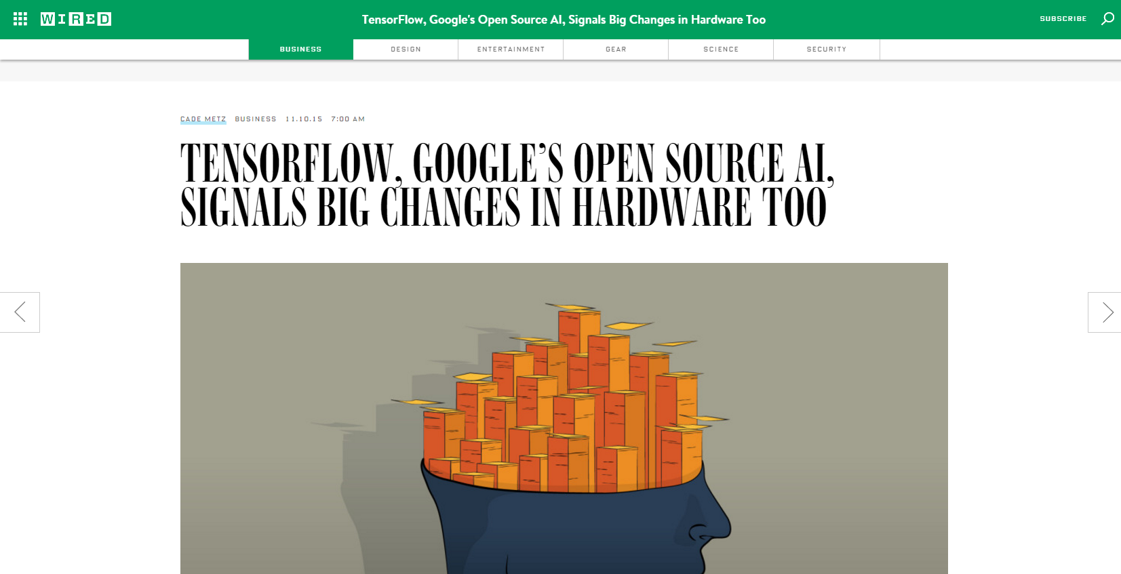
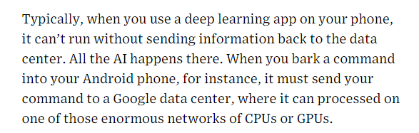
Application
http://www.wired.com/2015/11/googles-open-source-ai-tensorflow-signals-fast-changing-hardware-world/
Notes:
Considering the wide use of cellphone cameras even for professional photographers (the recent models have the capability of saving raw data for images) it is applicable once the image is white balanced notify the user about the percentage of accuracy we think the statistical methods have had on the image. If the image is classified as hard using the hybrid strategy by notifying the user, she can be guided for further processing of the image using an offline application like photoshop.

Slide 48
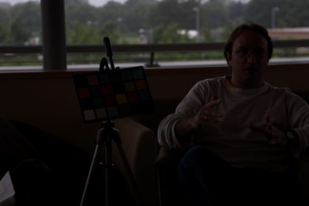
Removing false hard images from Gehler-Shi dataset
http://colour.cmp.uea.ac.uk/datasets/GehlerFalse.html

Slide 49
Thanks

